Slide 1
Secure Data Hiding in Image Using Steganography
CAPSTONE PROJECT
Presented By : Akshay Ramchandra Kadam
Student Name : Akshay Ramchandra Kadam
College Name & Department : Chatrapati Shahu Arts,Commerce & Science College,Lasur Station,Tq.Gangapur,Dist.Aurangabad.

Slide 2
OUTLINE
Problem Statement
Technology used
Wow factor
End users
Result
Conclusion
Git-hub Link
Future scope

Slide 3
Problem Statement
Data security is a major concern in today's digital world. Traditional encryption methods are effective, but they can raise suspicion. This project provides a way to hide secret messages inside images using steganography, ensuring secure communication without drawing attention.

Slide 4
Technology used
Python (Programming Language)
OpenCV (For image processing)
Tkinter (For GUI interface)
NumPy (For handling image data)

Slide 5
Wow factors
Hides text inside images without noticeable changes.
Password protection ensures extra security.
Easy-to-use GUI for both encryption & decryption.
Works with common image formats like PNG & JPG.

Slide 6
End users
Students & Researchers – To learn about steganography.
Journalists & Activists – To communicate sensitive information securely.
Cybersecurity Enthusiasts – To explore secure data hiding techniques.
Individuals & Organizations – To store confidential messages safely.

Slide 7
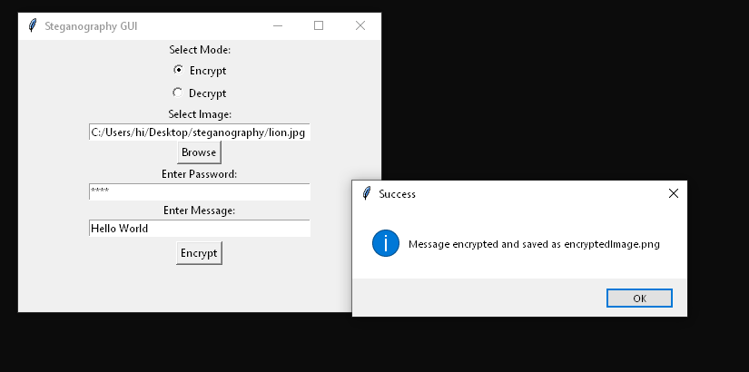
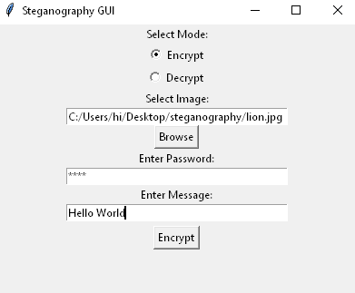
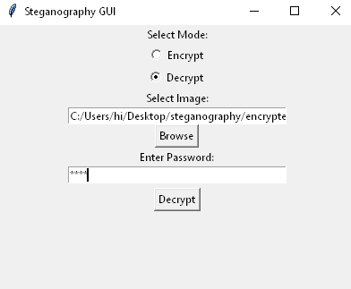
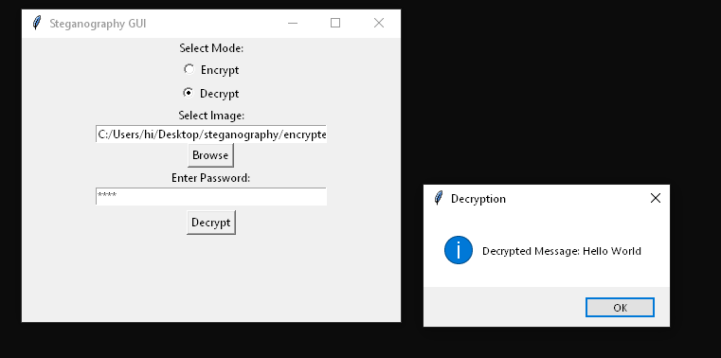
Results

Slide 8
Conclusion
This project demonstrates how steganography can be used for secure communication.
By embedding messages inside images, it offers a discreet way to transmit sensitive information.
The combination of image processing & encryption makes this tool effective and easy to use.

Slide 9
GitHub Link
https://github.com/akshaykadam-45/Steganography-project

Slide 10
Future scope(optional)
Support for more file formats (BMP, GIF).
Improved encryption using AES or RSA for added security.
Mobile application version.
Implement AI-based steganalysis to detect hidden messages.

Slide 11
THANK YOU

